Slide 1
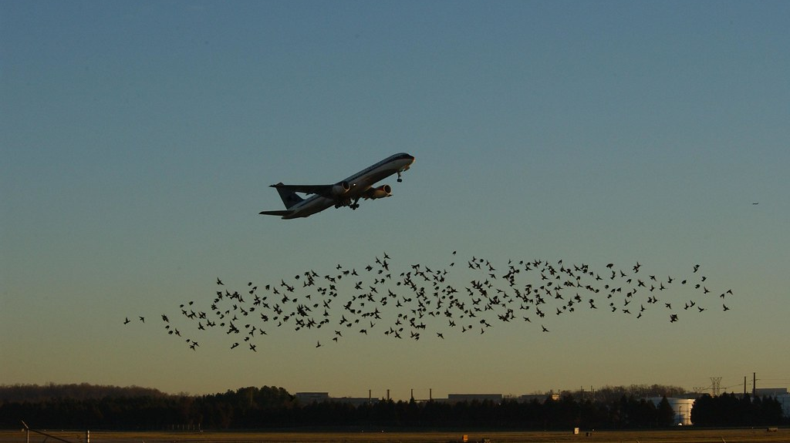
Aircraft Wildlife Strikes
Amrita Chandrasekar
NH53017

Slide 2
Outline
Introduction
Problem statement
Data collection
Data preprocessing
Exploratory data analysis
Machine learning models
Model evaluation results
Challenges
Future scope
Conclusion
Key takeaways

Slide 3
Introduction
Aim
This project investigates the significant global issue of wildlife strikes on aircraft, which poses a risk to both aviation safety and wildlife conservation. The analysis seeks to understand patterns in these incidents to inform better preventative measures.
Goals and Objectives
To understand the frequency and patterns of wildlife strikes on aircraft:
Analyze historical data to determine trends over time.
Identify peak times of the year, day, or specific conditions when wildlife strikes are most likely to occur.
To identify the species that are most commonly involved in strikes:
Determine which species pose the greatest risk to aircraft.
Understand the behavior and habitats of these species to inform mitigation strategies.
To develop predictive models that can estimate the likelihood and potential severity of wildlife strikes:
Utilize machine learning techniques to predict the damage level based on historical data.
Create a model to forecast the cost implications of wildlife strikes on aircraft repairs.

Slide 4

Problem Statement
Wildlife strikes pose risks such as aircraft damage, passenger safety hazards, and potential loss of life. This project aims to analyze and predict these incidents to enhance aviation safety measures.

Slide 5
Data Source and Collection
Kaggle
https://www.kaggle.com/datasets/dianaddx/aircraft-wildlife-strikes-1990-2023
About Dataset
Size:195MB
Time frame:1990-2023
Rows:288810
Columns:100

Slide 6

DataPreprocessing
The preprocessing involved the following:
Removing duplicates
Filling missing values with
Medians for numerical columns, and
Modes for categorical columns

Slide 7
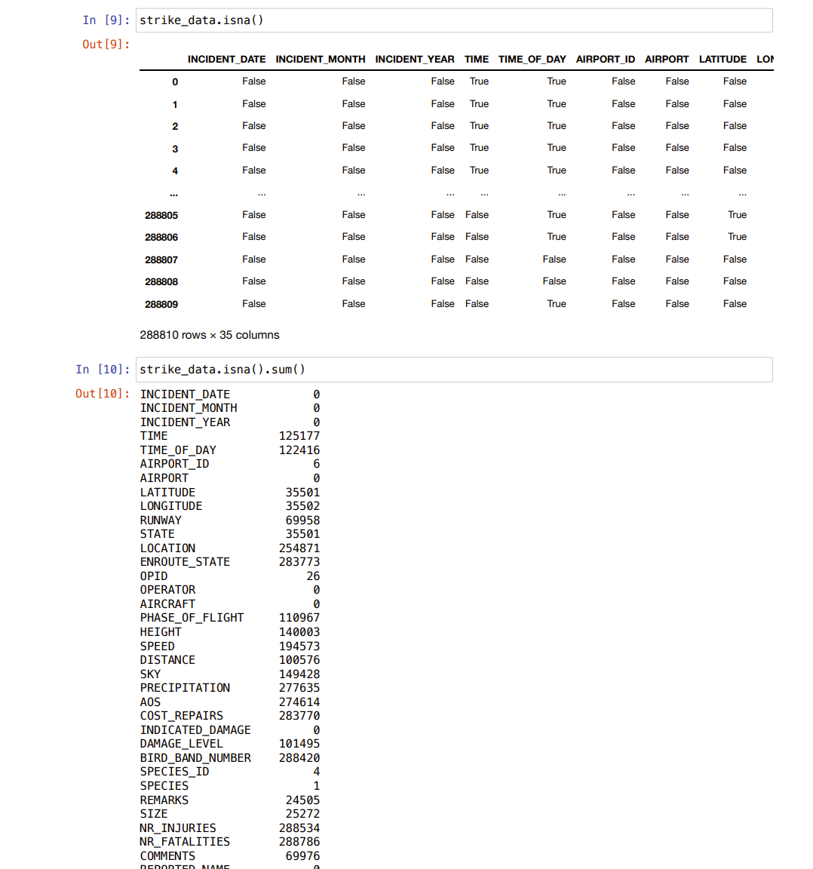
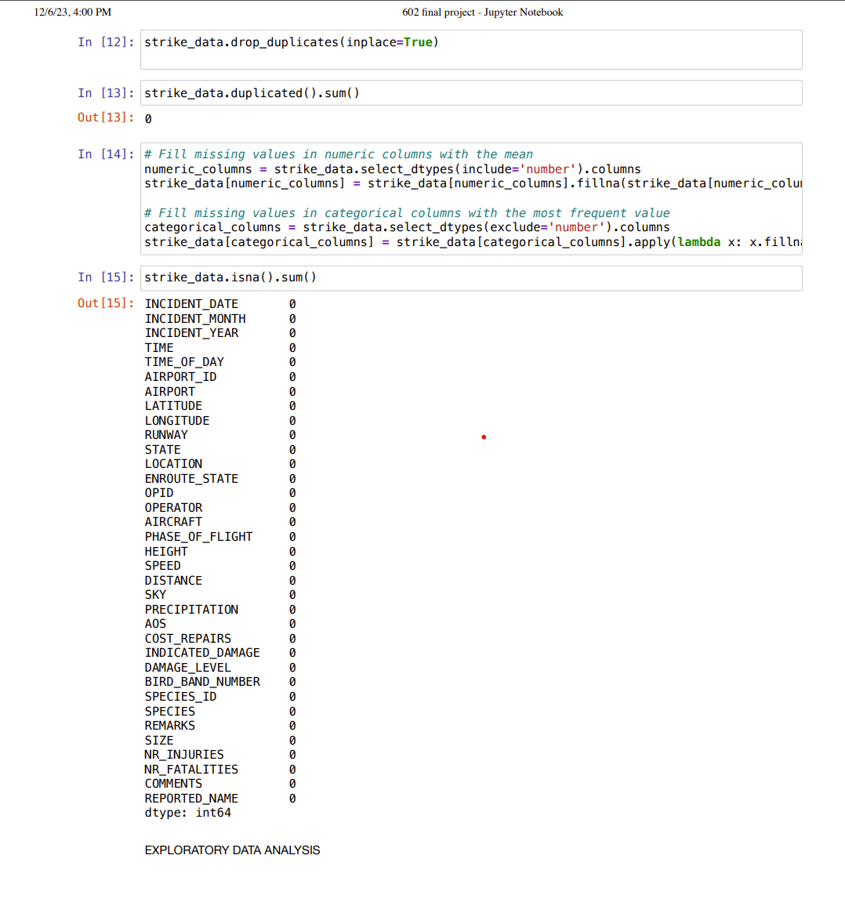

Slide 8

Exploratory Data Analysis
The EDA provides the below insights:
Incidents per year (Bar Chart)
Distribution of wildlife strikes by part of the day (Pie Chart)
Incidents by state (Bar Chart)
Top 10 species involved in strikes (Bar Chart)
Number of injuries and fatalities by aircraft type (Bar Charts)
Correlation matrix for numerical columns (Heatmap)

Slide 9
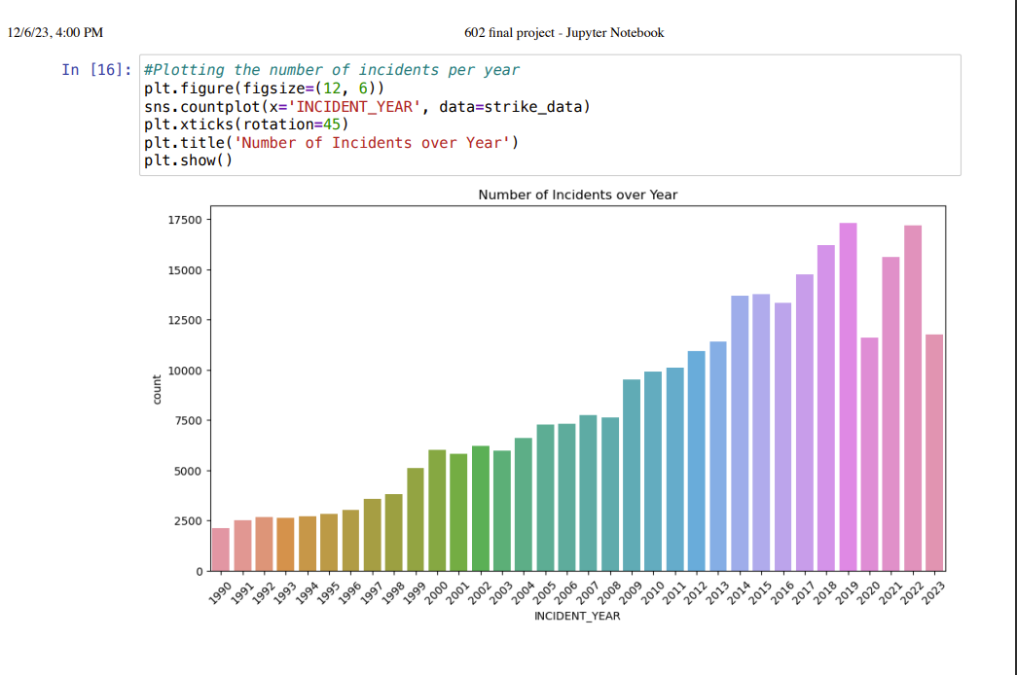
Exploratory Data Analysis
Incidents per year (Bar Chart)

Slide 10
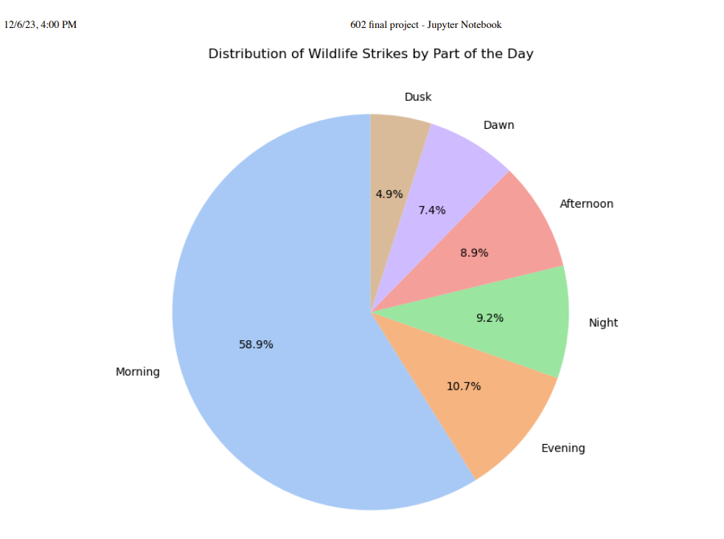
Exploratory Data Analysis
Distribution of wildlife strikes by part of the day (Pie Chart)

Slide 11
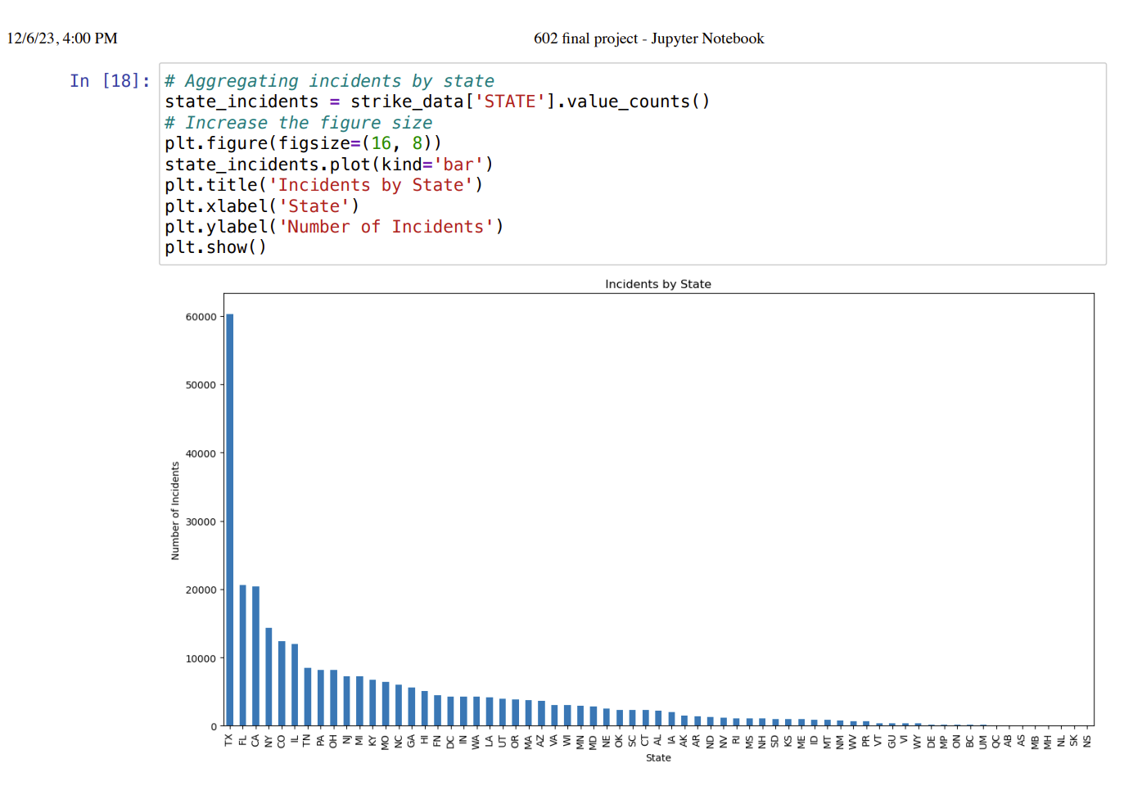
Exploratory Data Analysis
Incidents by state (Bar Chart)

Slide 12
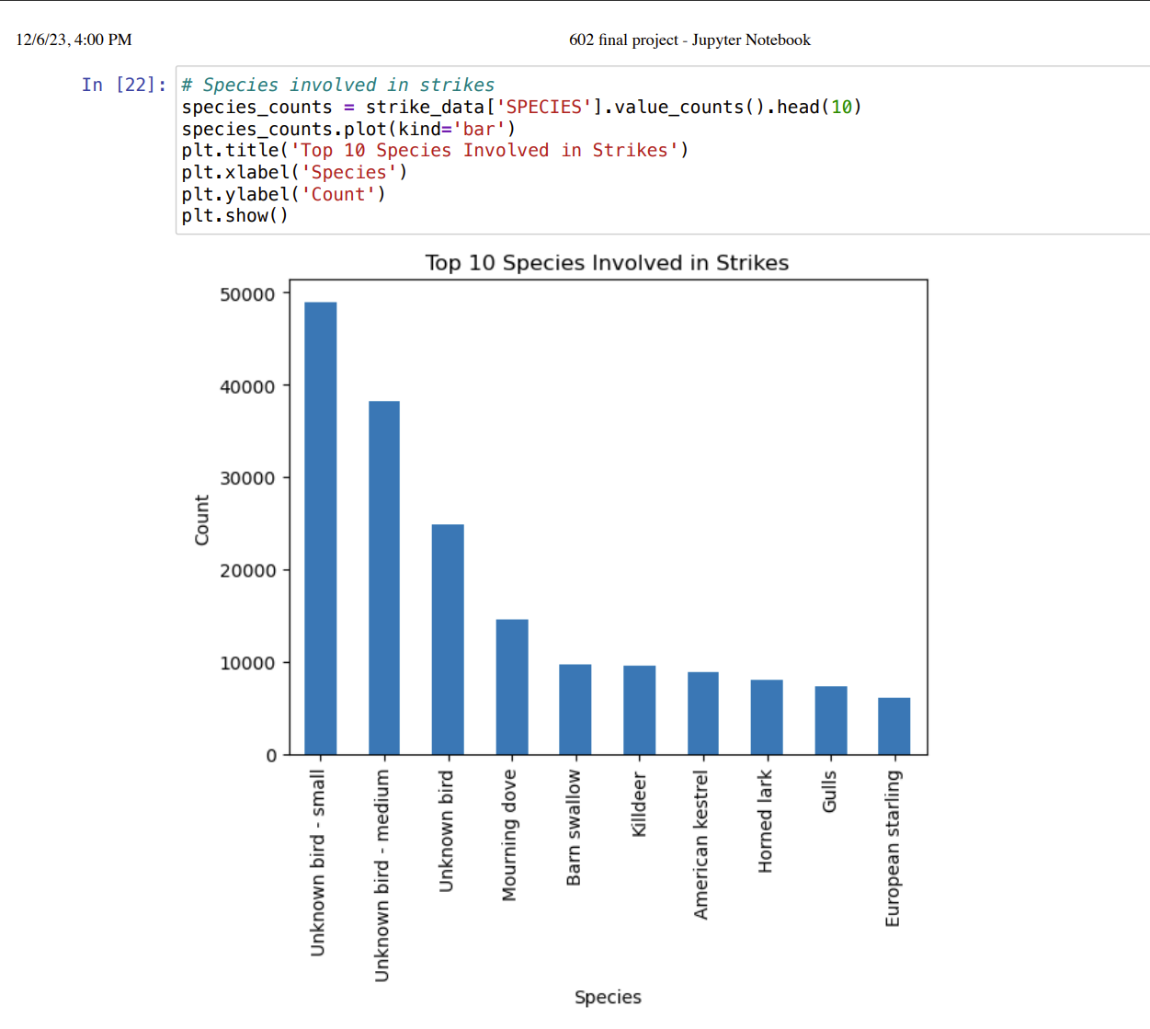
Exploratory Data Analysis
Top 10 species involved in strikes (Bar Chart)

Slide 13
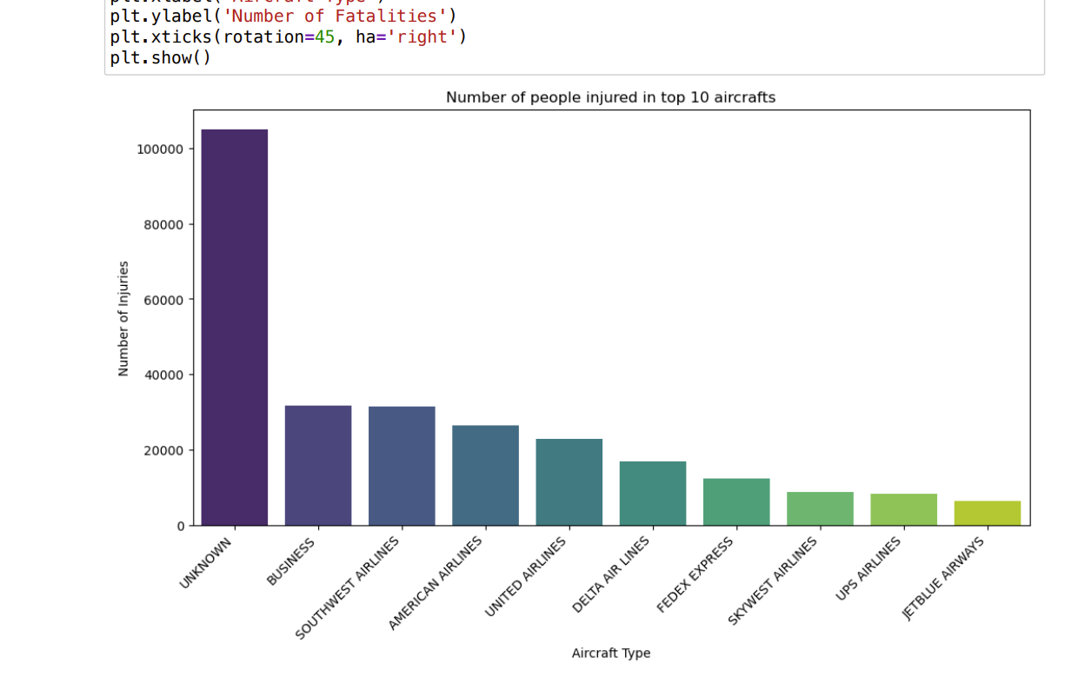
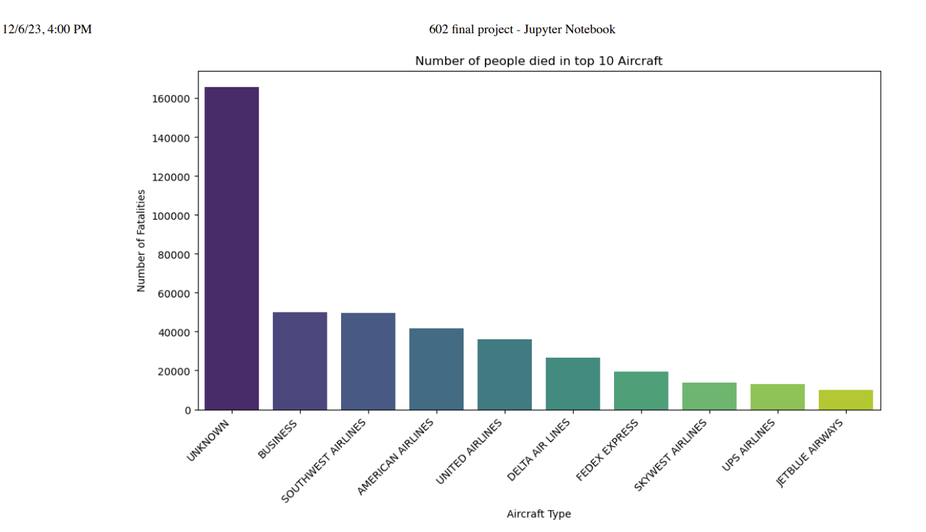
Exploratory Data Analysis
Number of injuries and fatalities by aircraft type (Bar Charts)

Slide 14
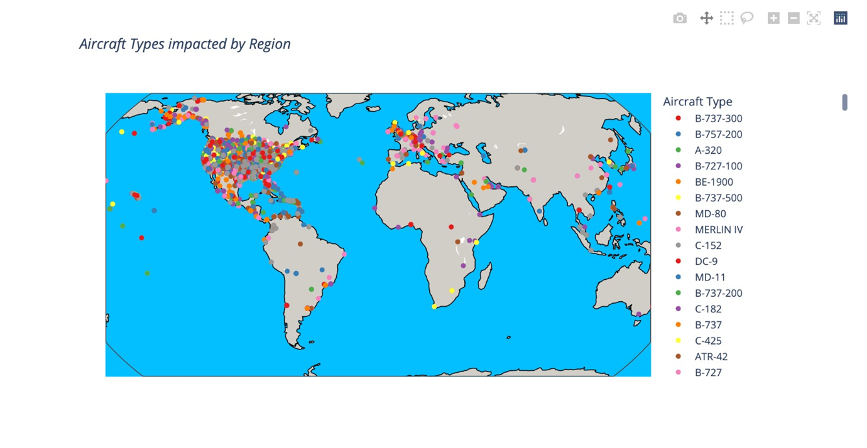
Exploratory Data Analysis
Aircrafts impacted by region

Slide 15
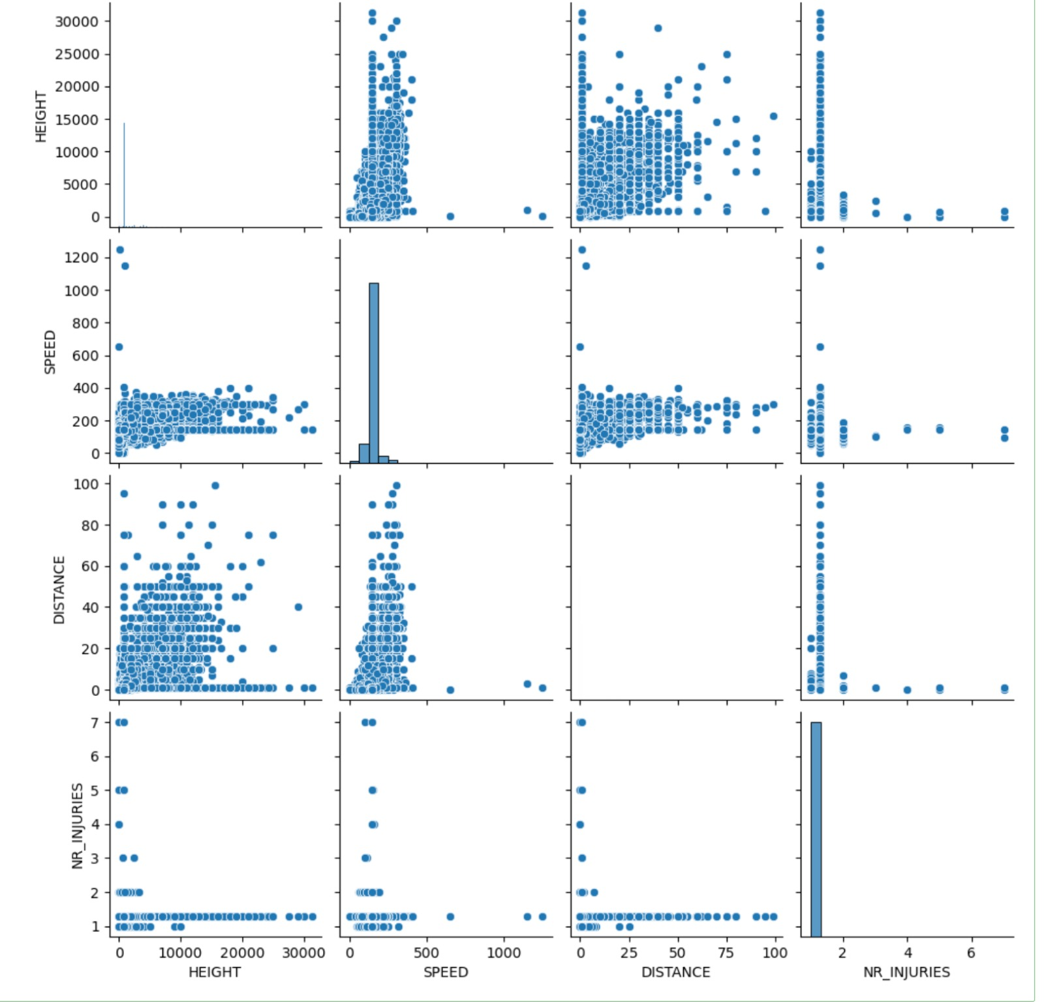
Exploratory Data Analysis
Pair plot between numerical columns

Slide 16
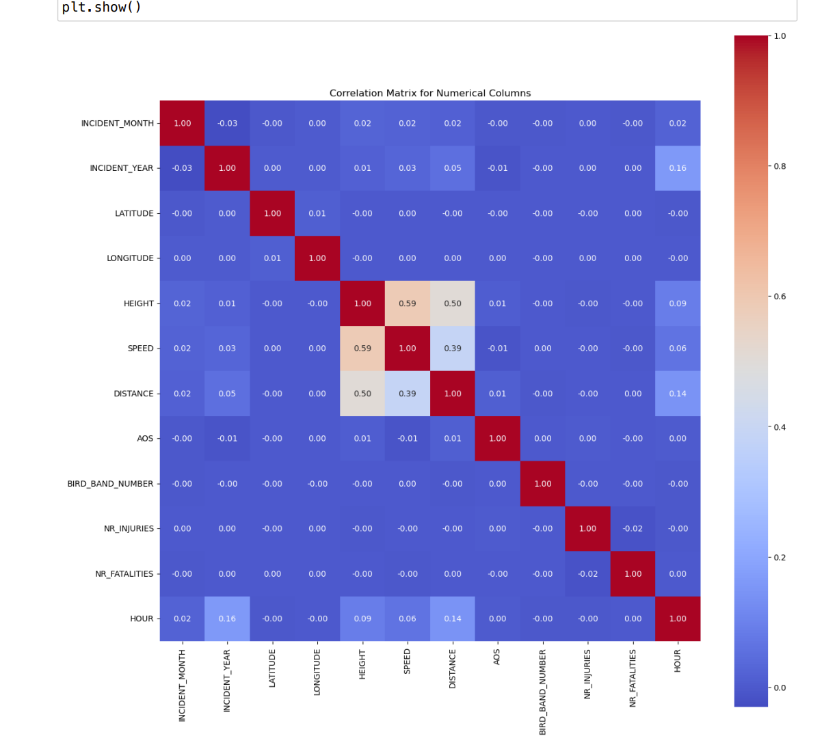
Exploratory Data Analysis
Correlation matrix for numerical columns (Heatmap)

Slide 17

Machine Learning Models
Classification:[Predicting Damage Level]
Random Forest Classifier
XGBoost Classifier
Logistic Regression Classifier
Regression:[Predicting Cost Repair]
Gradient Boosting Regressor
Linear Regression
Decision Tree Regressor
Clustering:[Determining Relationship B/W Damage And Cost Repair]
K-Means

Slide 18
Model Evaluation Results
Classification model’ s performance was assessed using accuracy, precision, recall, and f1-scores
Regression models were evaluated based on Mean Squared Error (MSE) and R-squared values.

Slide 19
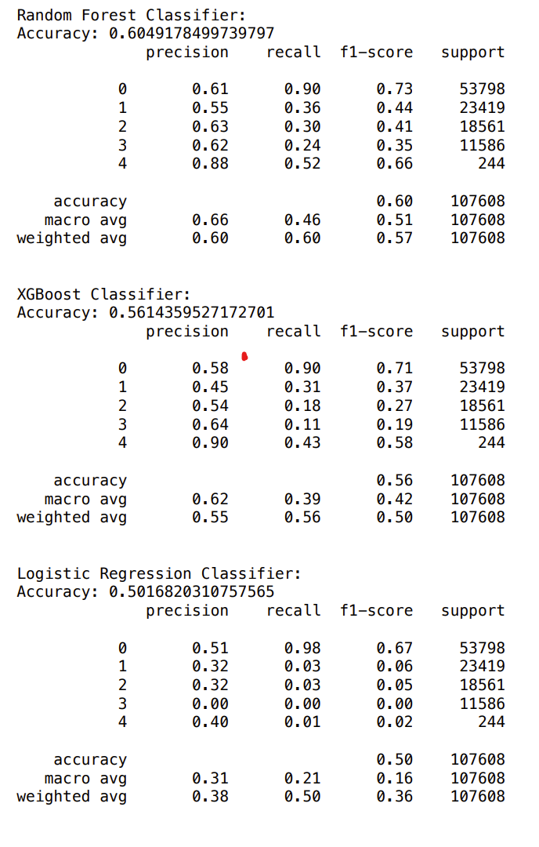
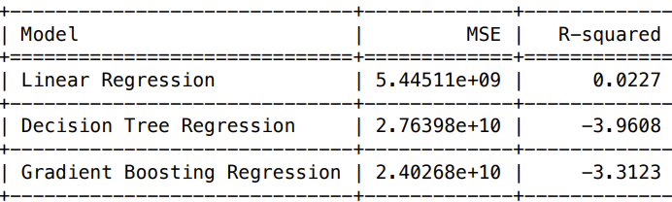
Model Evaluation Results

Slide 20

Challenges
Numerical and categorical data
Imbalanced classes in classification tasks- model sampling technique
Low R-squared values in regression - hyperparameter tuning technique

Slide 21
Future Scope
Enhance bird control measures and prevent bird strikes
Integration with Weather Data

Slide 22
Conclusion
Utilized machine learning to analyze and predict wildlife strikes on aircraft, enhancing aviation safety.
Advanced data analysis revealed key patterns, informing strategies to mitigate future incidents.
Provided valuable insights for wildlife strike prevention, demonstrating the effectiveness of data-driven approaches.

Slide 23
KEY TAKEAWAYS
Machine Learning Efficiency: Showcased machine learning's capability in predicting wildlife strikes.
Data-Driven Insights: Uncovered vital patterns for strategic strike prevention.
Data Quality Emphasis: Stressed the importance of thorough data preprocessing.
Room for Enhancement: Identified opportunities for improving data balance and model accuracy.
Real-World Impact: Demonstrated practical applications in aviation safety and wildlife management.

Slide 24
References
(1)Altringer, L., Navin, J., Begier, M. J., Shwiff, S. A., & Anderson, A. (2021). Estimating wildlife strike costs at US airports: A machine learning approach. Transportation Research Part D: Transport and Environment, 97, 102907. https://doi.org/10.1016/j.trd.2021.102907
(2)Wei, K., Liu, W., Sui, Y., Guo, W., & Yu, G. (2022). Motion detection of bird based on optical radar. 2022 IEEE 4th International Conference on Civil Aviation Safety and Information Technology (ICCASIT). https://doi.org/10.1109/iccasit55263.2022.9986743(Future Scope)
(3)Andrews, R., Bevrani, B., Colin, B., Wynn, M. T., Ter Hofstede, A. H. M., & Ring, J. (2022). Three novel bird strike likelihood modelling techniques: The case of Brisbane Airport, Australia. PLOS ONE, 17(12), e0277794. https://doi.org/10.1371/journal.pone.0277794(Future Scope)

Slide 25


